Slide 1





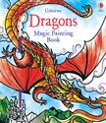














St Mark’s
Usborne Book Fair
Nov. 18th and Nov. 22nd
In the gym, after Sunday Mass
Order online at :
https://L3719.myubam.com/1895805
School receives 50% in free books off every purchase.

